Slide 1

AI Pose Estimation using OpenCV and Mediapipe
Bicep Curl Counter
Adepu bharath kumar

Slide 2
Technologies used
Python
OpenCV
MediaPipe
Numpy

Slide 3
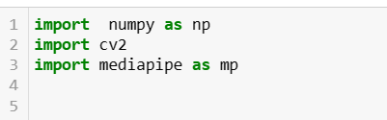
Step by Step Process
Step 1
Import libraries
import numpy as np
import cv2
import mediapipe as mp

Slide 4
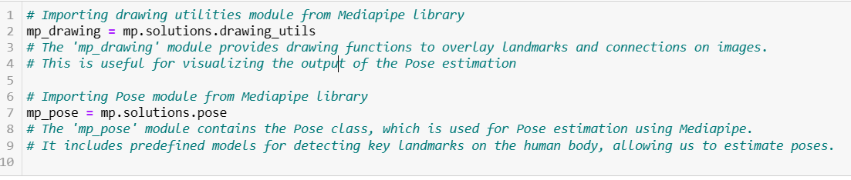
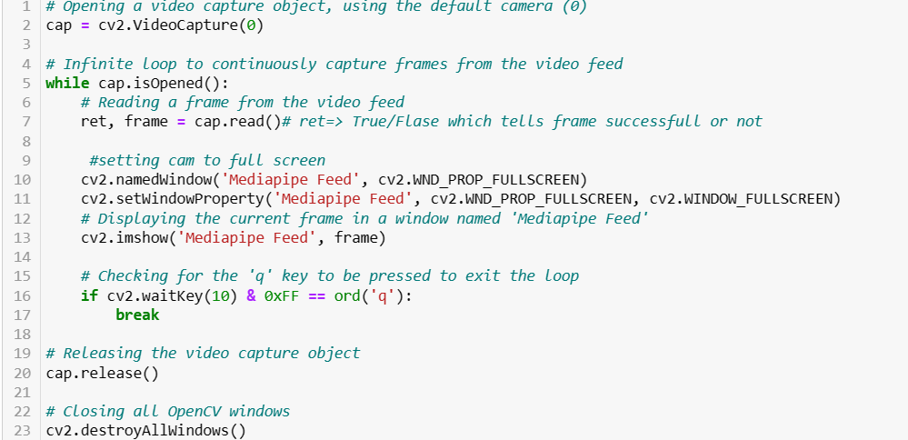
Step 2
Setting up mp drawing and pose
Step 3
Setting up the video feed

Slide 5
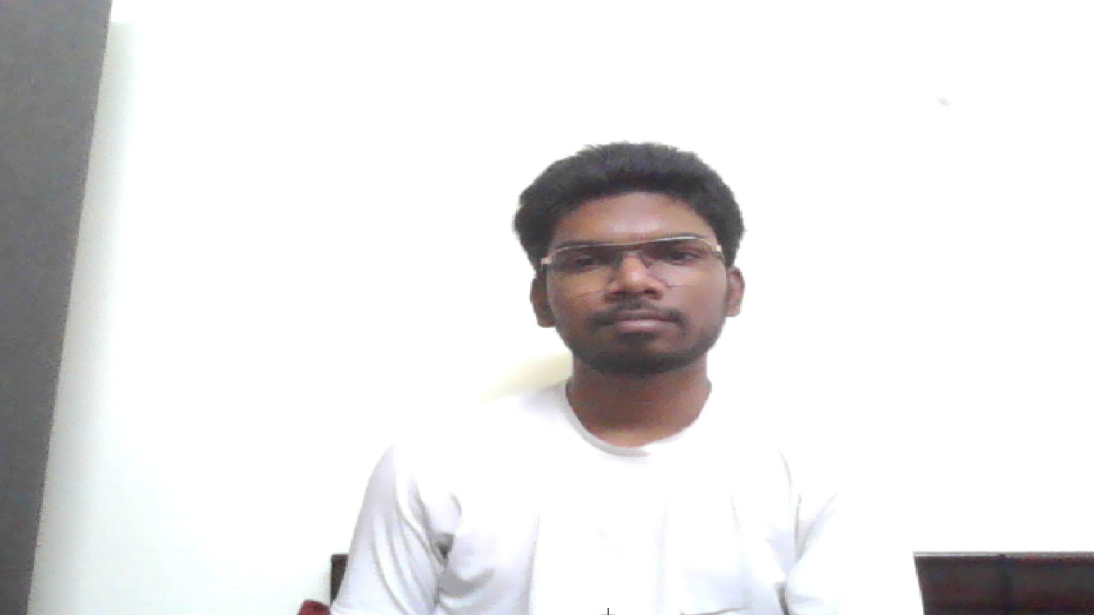

Slide 6
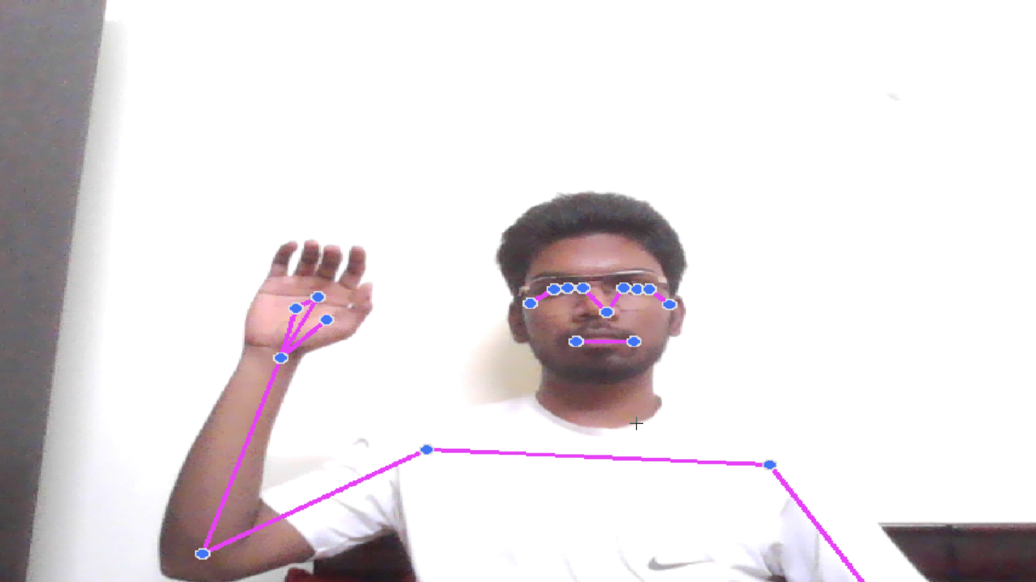
Step 3
Make detections and 2. Estimating Poses

Slide 7
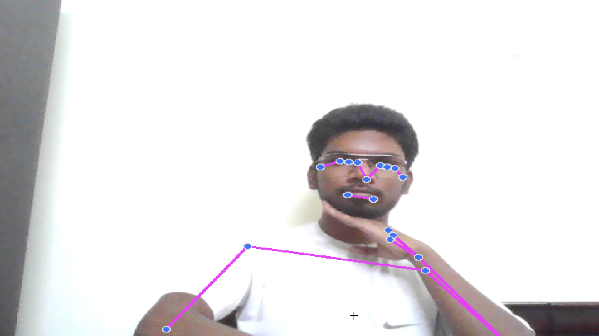
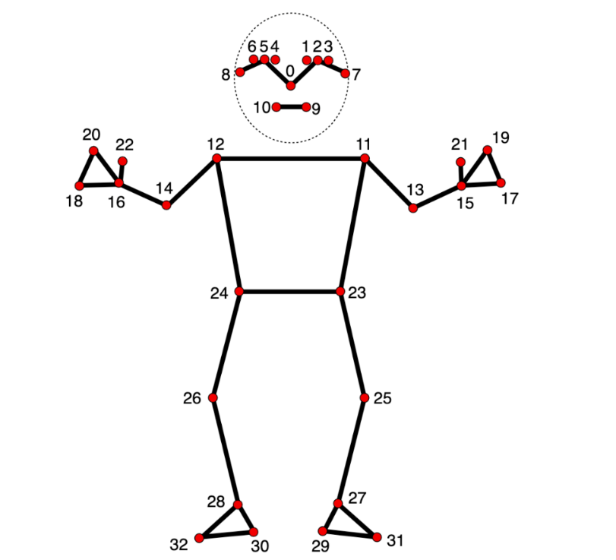
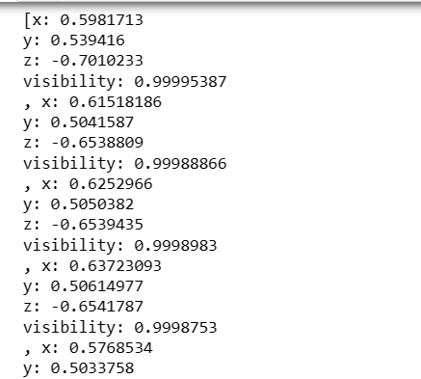
Step 4
Extracting Joint Coordinates

Slide 8
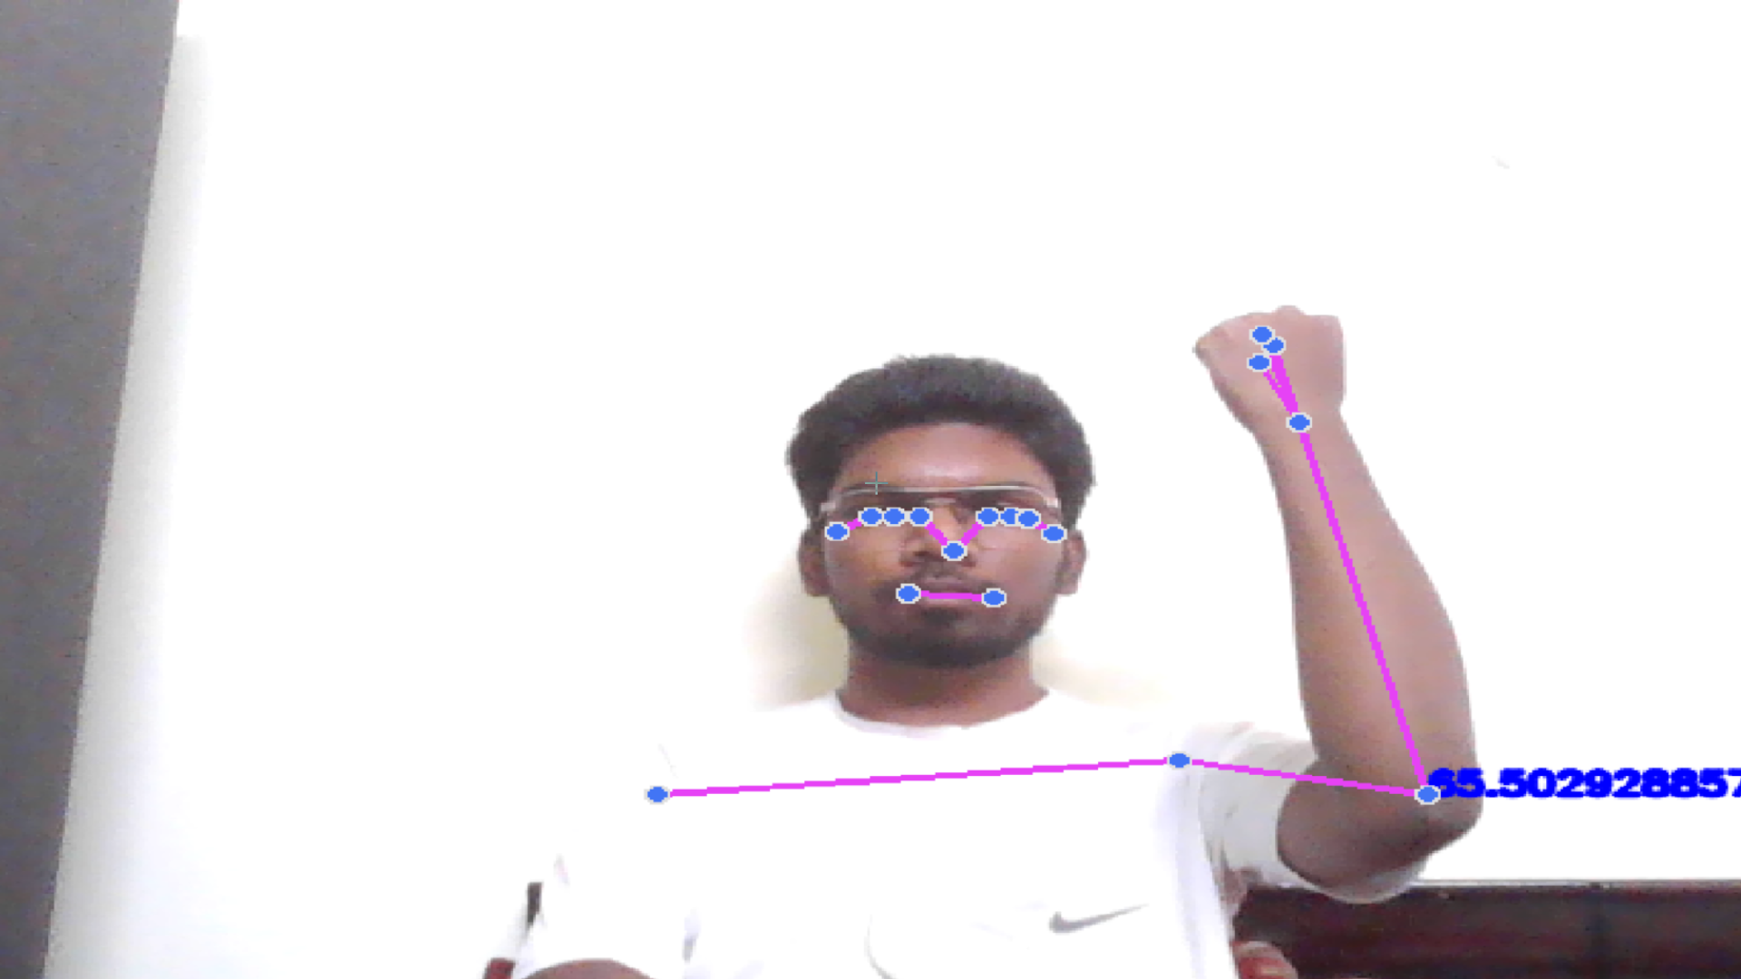
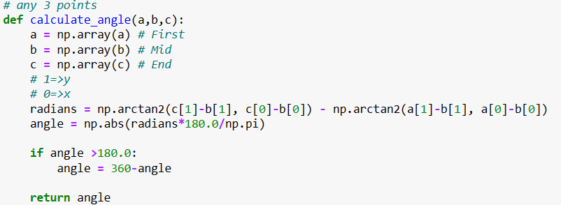
Step 5
Calculating Angles Between Joints

Slide 9
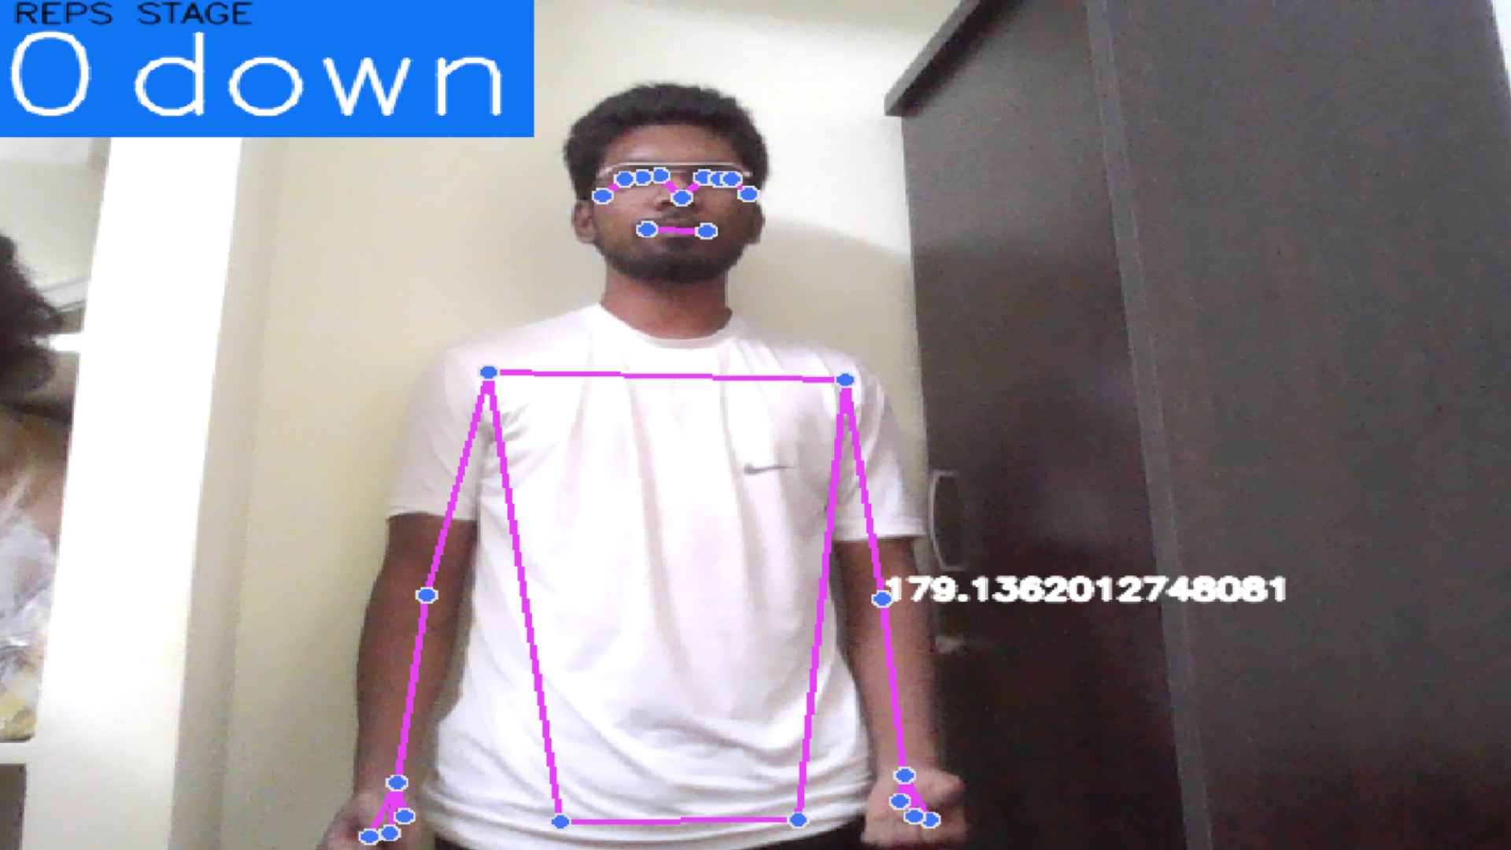
Step 6
Building a Gym Curl Counter¶

Slide 10
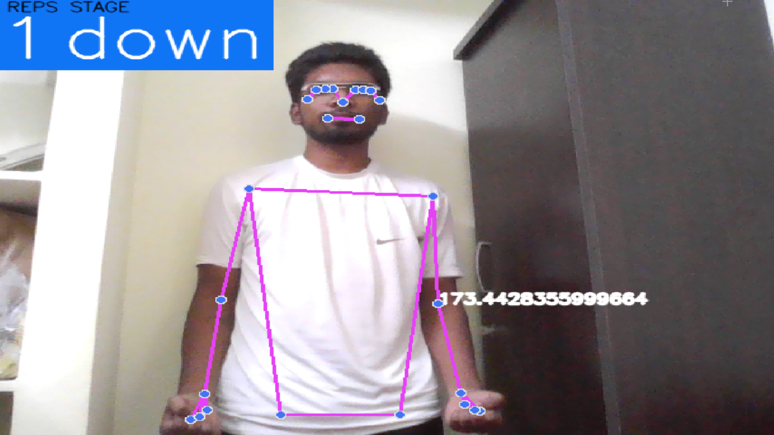

Slide 11
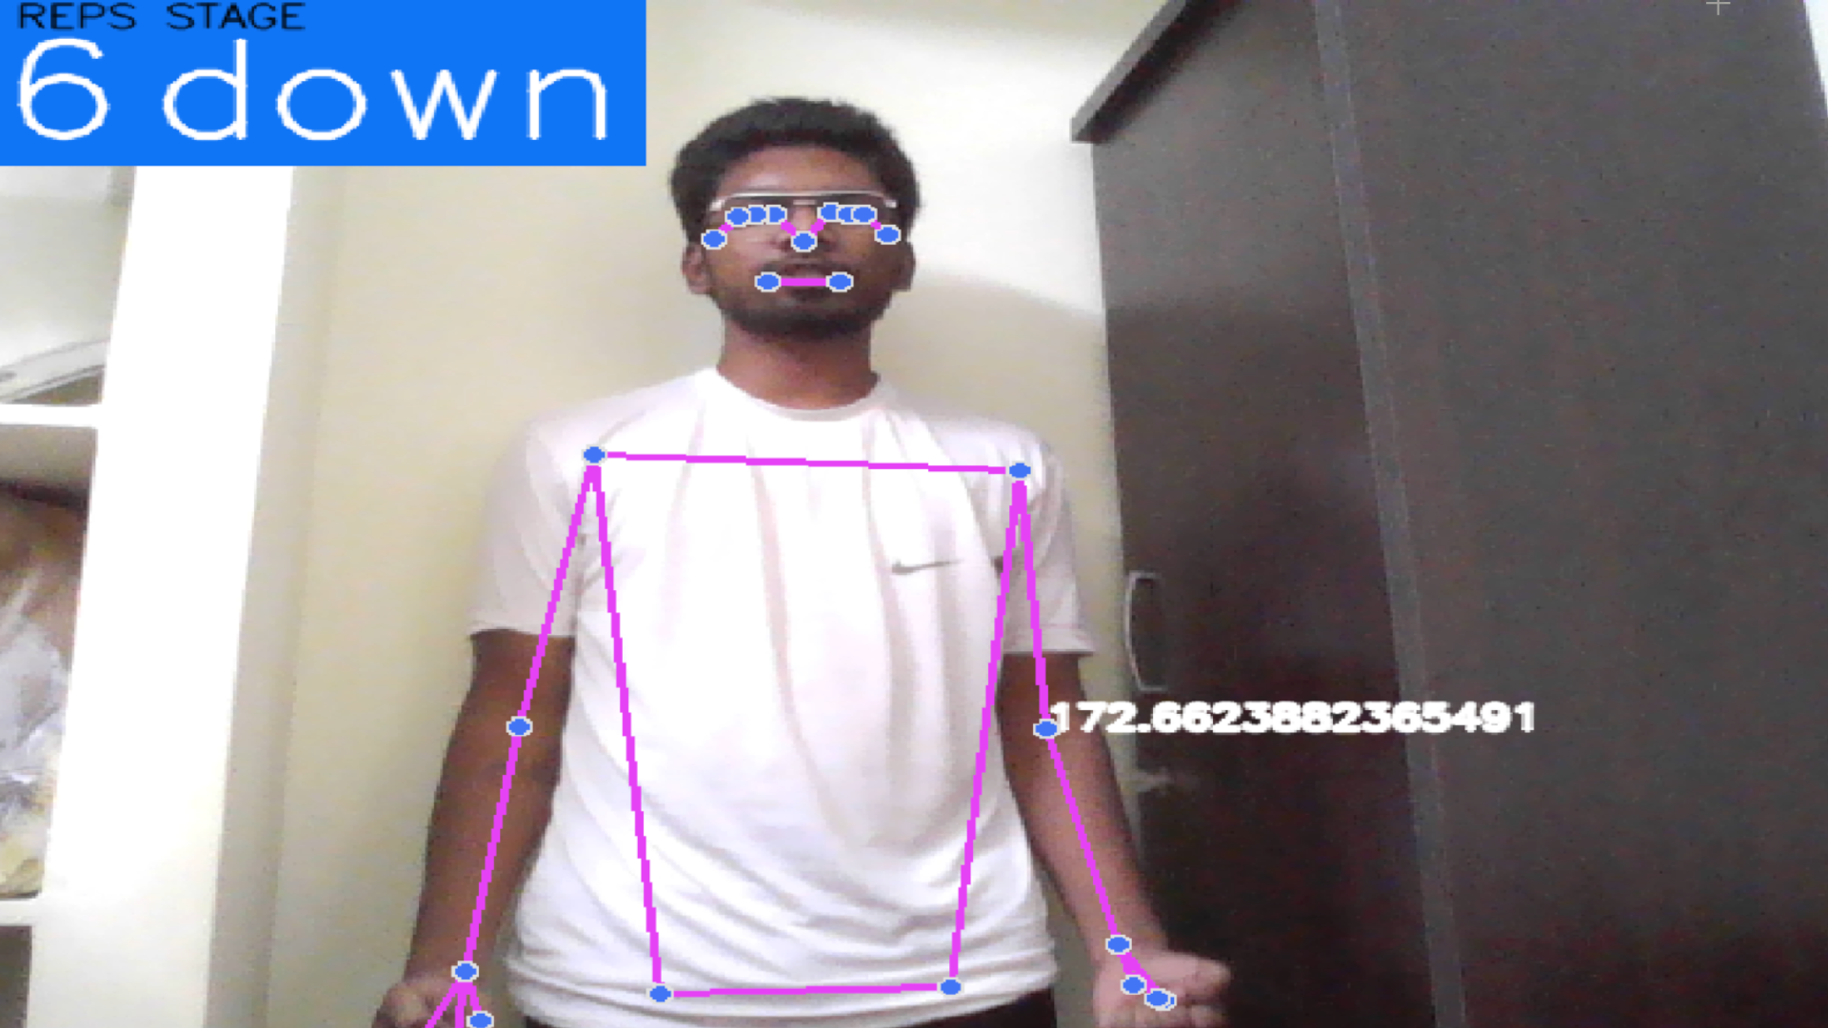

Slide 12
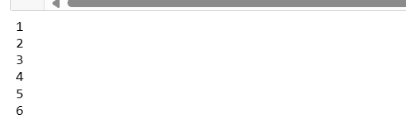

Slide 13
Thank you
Code available in github and linkedin

